Slide 1
Eaglepointe Landslide
North Salt Lake, Utah
Group 8
Levi Ekstrom
Christian Cano
Samantha Ruggles

Slide 2
Model Video
https://youtu.be/iGRnobUbxHE
Time Lapse Video
https://www.youtube.com/watch?v=NQs_OWgNshg

Slide 3
Background and Site Description
UGS had documented small shallow landslides in the mid 2000s.
The upper part of the slope corresponds to Lake Bonneville’s highstand shoreline.
The site is underlain by lake sand, gravel and volcanic sediments.
The Eaglepointe subdivision surrounds the slope and it includes the construction of several houses on the south side of Parkway Drive at the bottom of the slope.

Slide 4
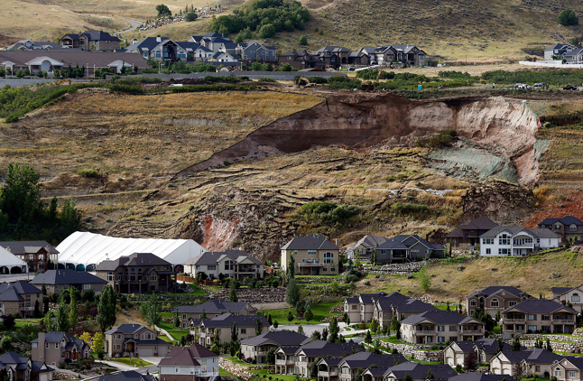
Landslide Description
At about 6:00 a.m. on the morning of August 5, 2014, a large landslide occurred above Parkway Drive in the City of North Salt Lake, Davis County.
The landslide involved an engineered slope that had been part of a gravel pit in the 1990s, but has since been reclaimed and partially developed into the Eaglepointe subdivision.

Slide 5
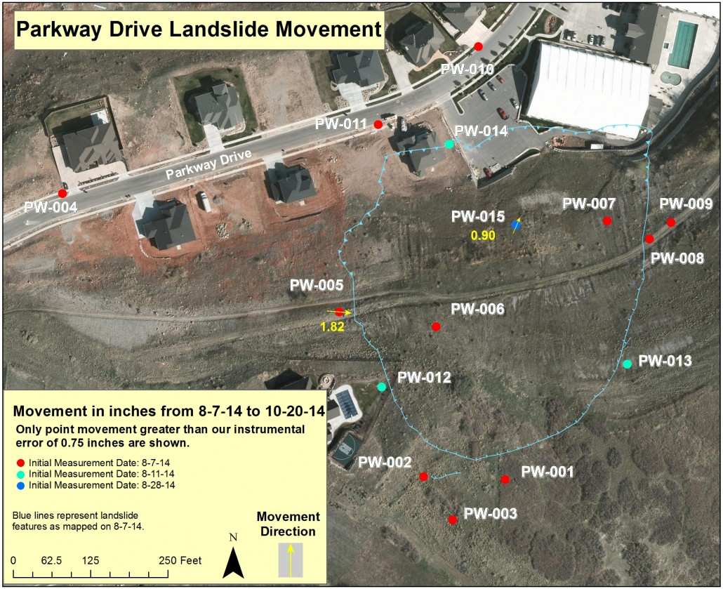
Landslide Description
The catastrophic failure of the reclaimed slope above Parkway Drive resulted in a 60-foot-high main scarp above a landslide mass about 500 feet wide and 500 feet long that moved downhill several tens of feet.

Slide 6
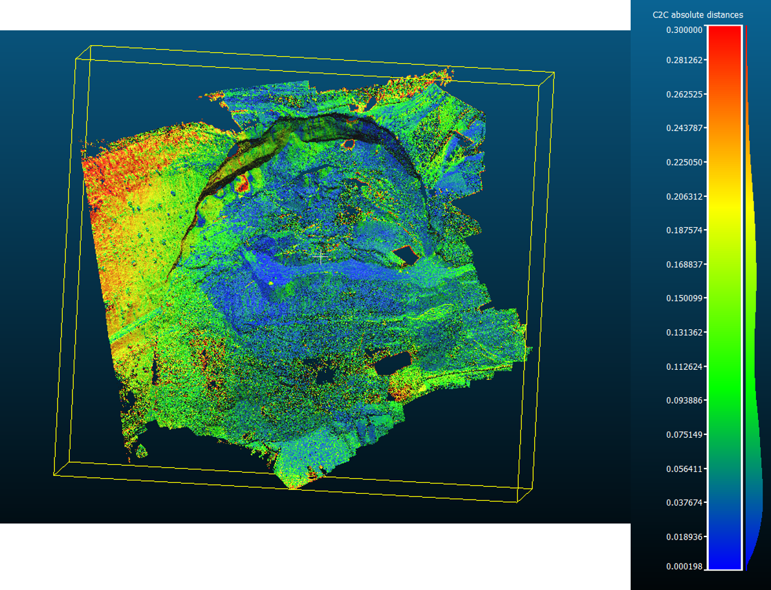
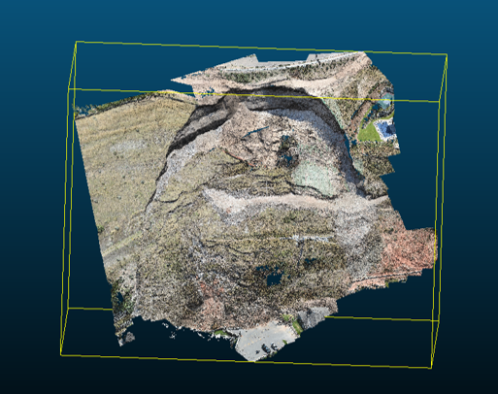
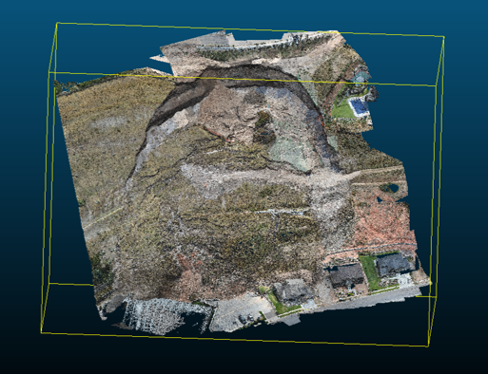
Preliminary estimates suggest a landslide volume of 300,000 to 400,000 cubic yards, based on an assumed depth of between 30 and 50 feet. The pre-slide slope had a local relief (change in elevation) of about 200 feet and an average grade of approximately 45%.

Slide 7
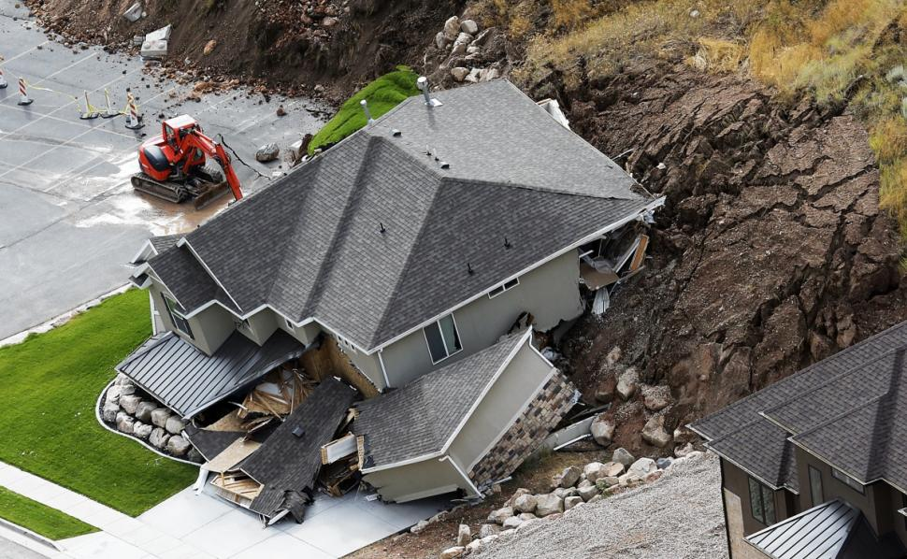
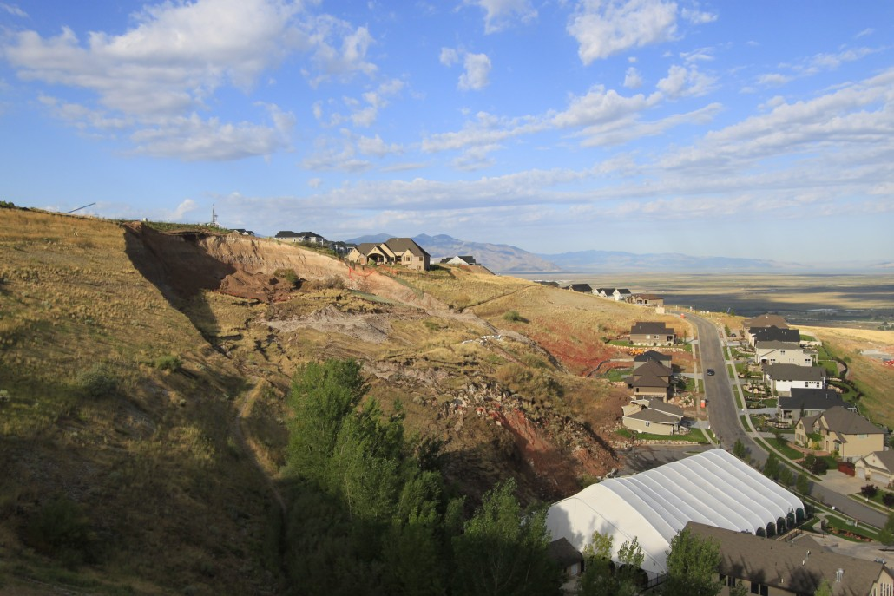
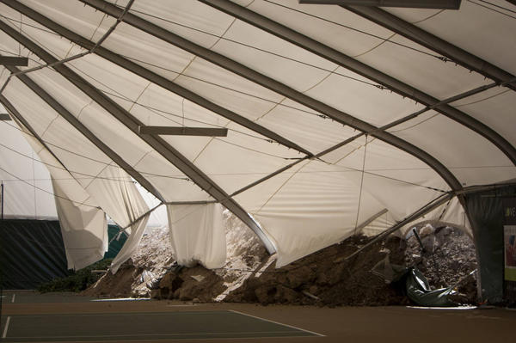
Damage
Only one house was directly damaged. The home was pushed off its foundation and destroyed.
A tennis court was also damaged.
A backyard and part of a hiking trail were carried away by the landslide.
Immediately after the landslide, 27 homes were evacuated.
No one was injured during the landslide.

Slide 8
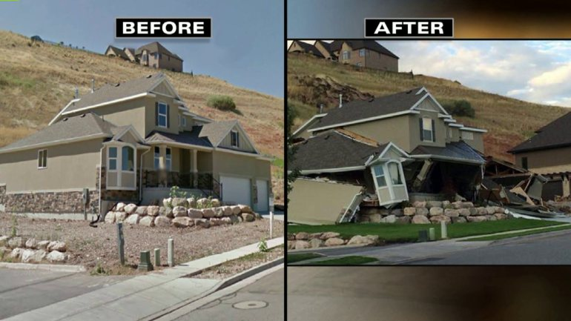
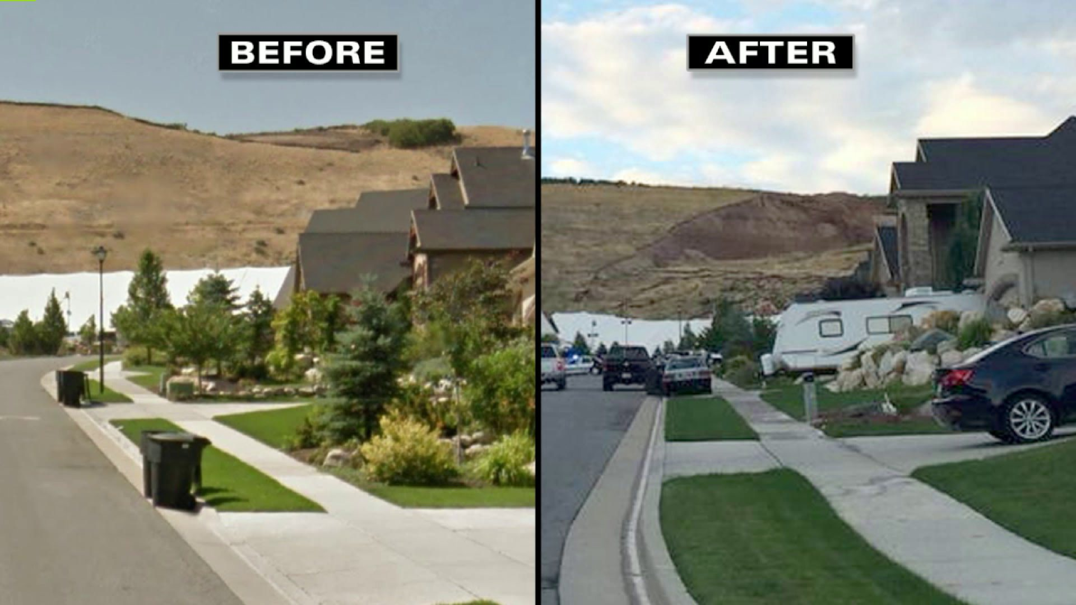
Geotechnical Reports
AGRA Earth and Environmental (1998)
Preliminary for the development
AGEC (2003)
Further investigation for the proposed Eaglepointe development
GSH (2013)
Proposed expansion of the Eaglepointe development

Slide 9
AGRA Earth & Environmental (1998) Geotechnical Report
Preliminary investigation for the proposed Eaglepointe residential development
Identified landslide and slope stability hazards using natural hazard maps created by Lowe (1989)
Noted that extensive gravel and sand mining had been conducted in the proposed site
No slope stability analysis performed
Conclusion
For the development, “A study is unlikely to be necessary in this area”

Slide 10
AGRA Earth & Environmental (1998) – Geological Hazard Map

Slide 11
AGRA Earth & Environmental (1998) – Site Today

Slide 12
AGEC (2003) Geotechnical Report
Further investigation for the proposed Eaglepointe development
Also used natural hazard maps created by Lowe (1989) to characterize landslide and slope stability hazards for the site
Noted that no slides had occurred outside areas that had no gravel and sand mining
Selected three profiles for slope stability analysis for existing and “weathered” conditions
Infinite wedge, sliding wedge, and circular failure examined using modified Bishop’s method

Slide 13
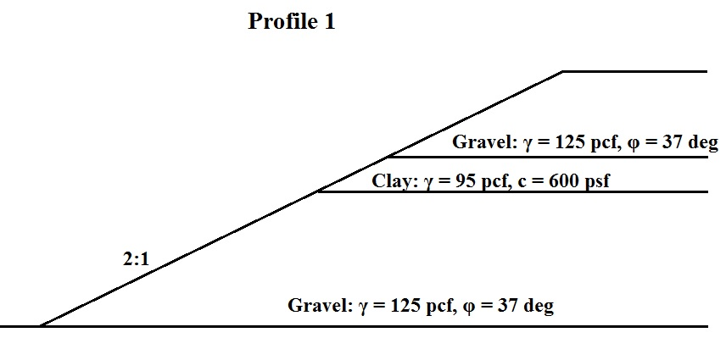
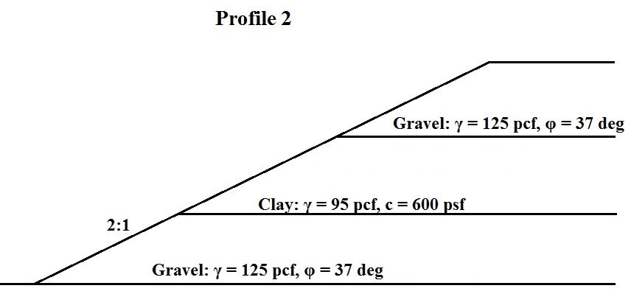
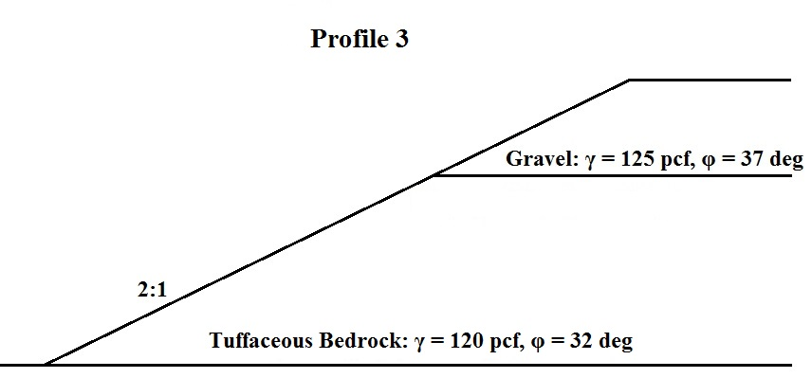
AGEC (2003) Geotechnical Report
Slope Profiles Used

Slide 14
AGEC (2003) Geotechnical Report
Conclusions
FS > 1.5 for all profiles
Total stress analysis
No groundwater in the slope
Slopes will stay stable as long as:
Material strengths are at least as strong as “unweathered” conditions
Groundwater stays out of slopes
Pore pressures are not elevated

Slide 15
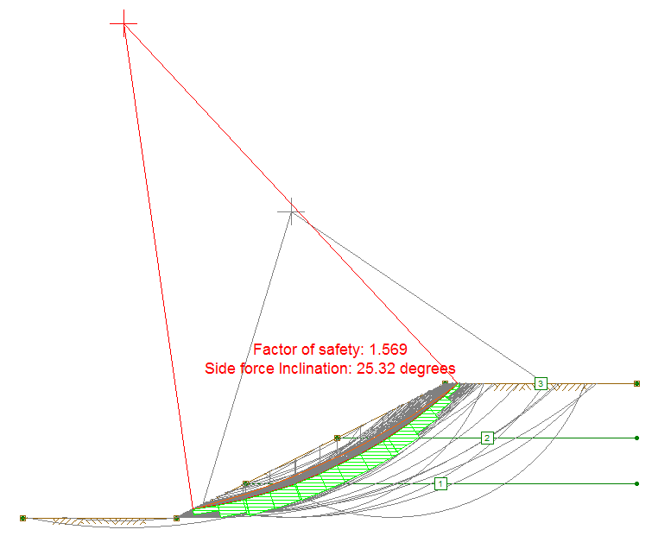
AGEC (2003) Geotechnical Report
To verify AGEC results, slope stability analysis was performed using UTEXASED for worst case profile.
FS = 1.57

Slide 16
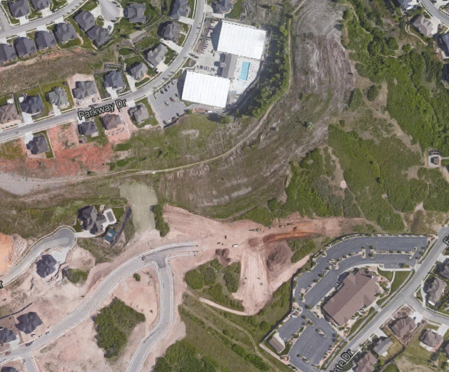
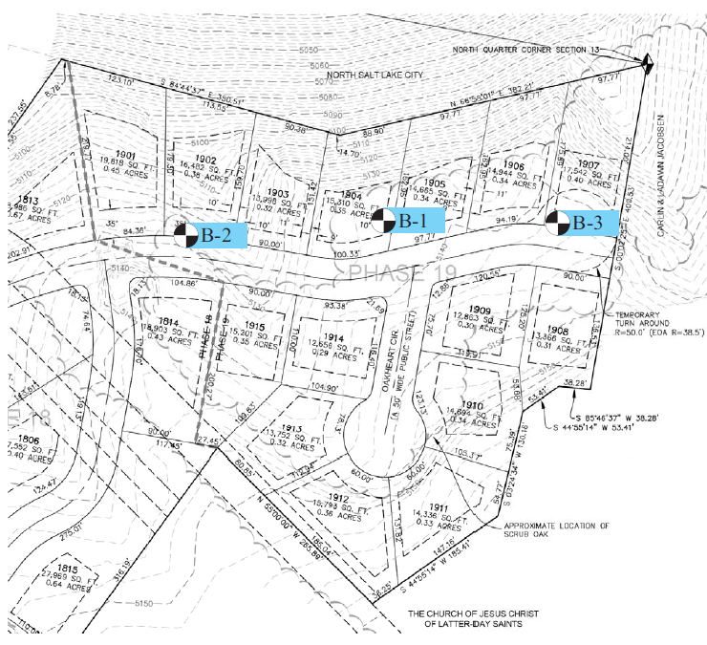
GSH Geotechnical (2013) Geotechnical Report
Proposed expansion of the Eaglepointe development
Lots 1901 to 1907

Slide 17
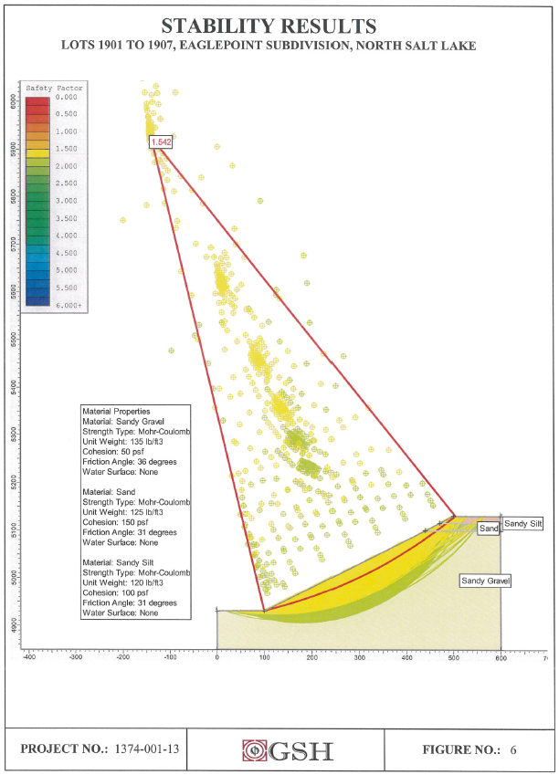
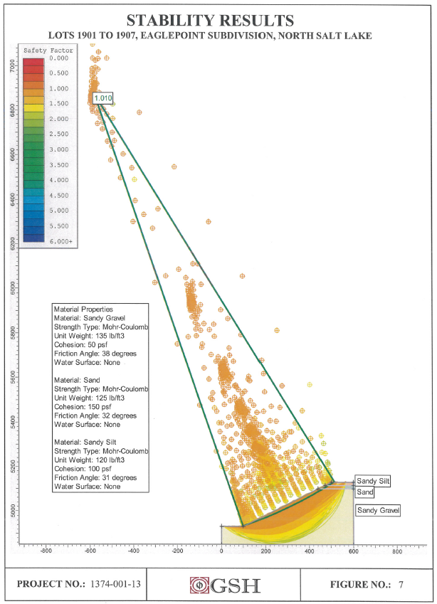
GSH Geotechnical (2013) Geotechnical Report
Stability Analysis performed using SLIDE (Limit equilibrium Simplified Bishop’s method)
Analyzed actual slope that failed
Used total stress analysis, with no groundwater in slope
FS = 1.542 for static and FS = 1.010 for seismic

Slide 18
Conclusions
The slope stability analysis from all geotechnical reports used a total stress procedure with no groundwater in the slope to determine the FS.
The rainfall from July and August of 2014 was high, but not unusually so.
The 2003 geotechnical report from AGEC did point out that if water was introduced to the slope, there could be an issue with stability.
The 2013 geotechnical report from GSH Geotechnical analyzed the actual slope that failed, but did not consider a saturated slope.
It is possible that an increased rainfall coupled with an inaccurate slope stability analysis could have led to the Eaglepointe landslide.

